Slide 1

Food Delivery Time Prediction
Using Naive Bayes, K-Nearest Neighbors, and Decision Tree
Machine Learning Mini Project

Slide 2

Introduction
The Digital Food Revolution
Online food delivery platforms have experienced exponential growth in recent years, transforming how consumers access meals. With millions of orders processed daily, these platforms face increasing pressure to meet customer expectations.
The ability to accurately predict delivery times has become a critical competitive advantage in this fast-paced industry.
Customer Satisfaction
Operational Efficiency
Business Growth
Accurate delivery predictions directly impact user experience and retention rates
Better forecasting enables optimal resource allocation and route planning
Reliable service builds trust and drives platform adoption

Slide 3




Problem Statement & Objective
Research Question
Can we accurately predict whether a food delivery will arrive on time or be delayed based on order characteristics and environmental factors?
Binary Classification
Fast Delivery (0)
Delayed Delivery (1)
Two-class prediction problem
Orders arriving on time
Orders arriving late
This classification enables proactive communication with customers and helps delivery platforms optimize their operations by identifying potential delays before they occur.

Slide 4
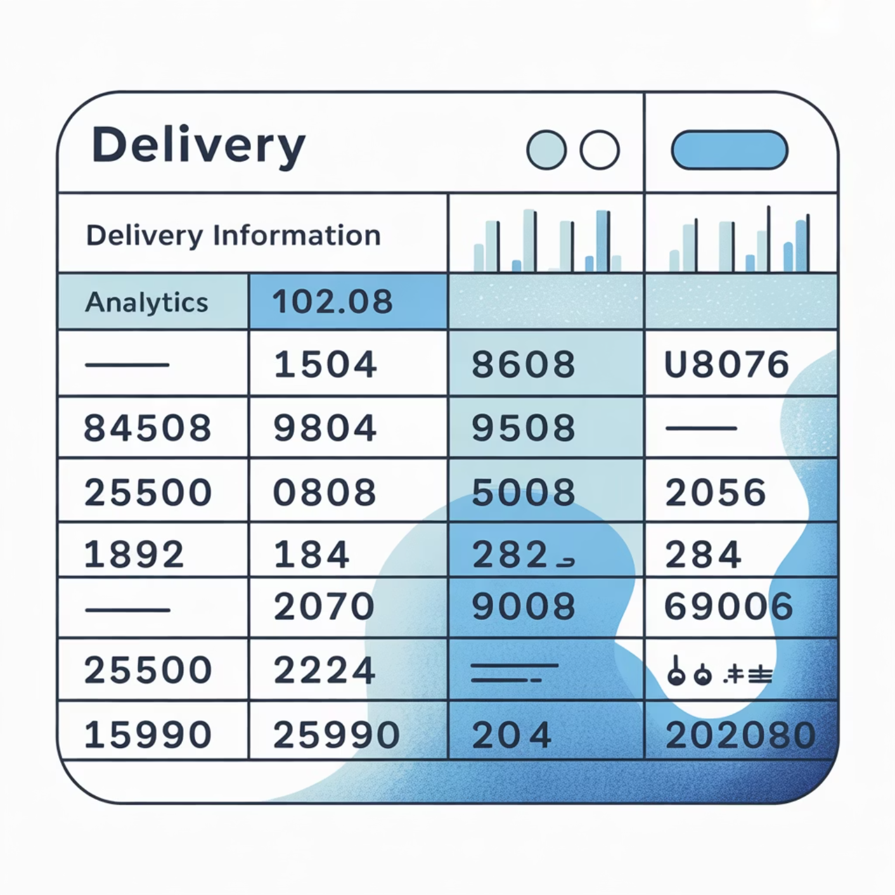

Dataset Overview
Data Characteristics
Our analysis utilizes a comprehensive food delivery dataset containing real-world order information. The dataset captures multiple dimensions of the delivery process, from order placement through final delivery.
Each record represents a single delivery transaction with associated features that influence delivery time outcomes.
Distance
Weather Conditions
Geographical separation between restaurant and customer location
Environmental factors affecting delivery speed
Traffic Density
Order Priority
Road congestion levels during delivery window
Urgency classification of delivery requests
Vehicle Type
Ratings
Mode of transportation used for delivery
Historical performance metrics of delivery personnel
Target Variable: Derived from actual delivery time measurements, classified as binary outcome (Fast or Delayed)

Slide 5
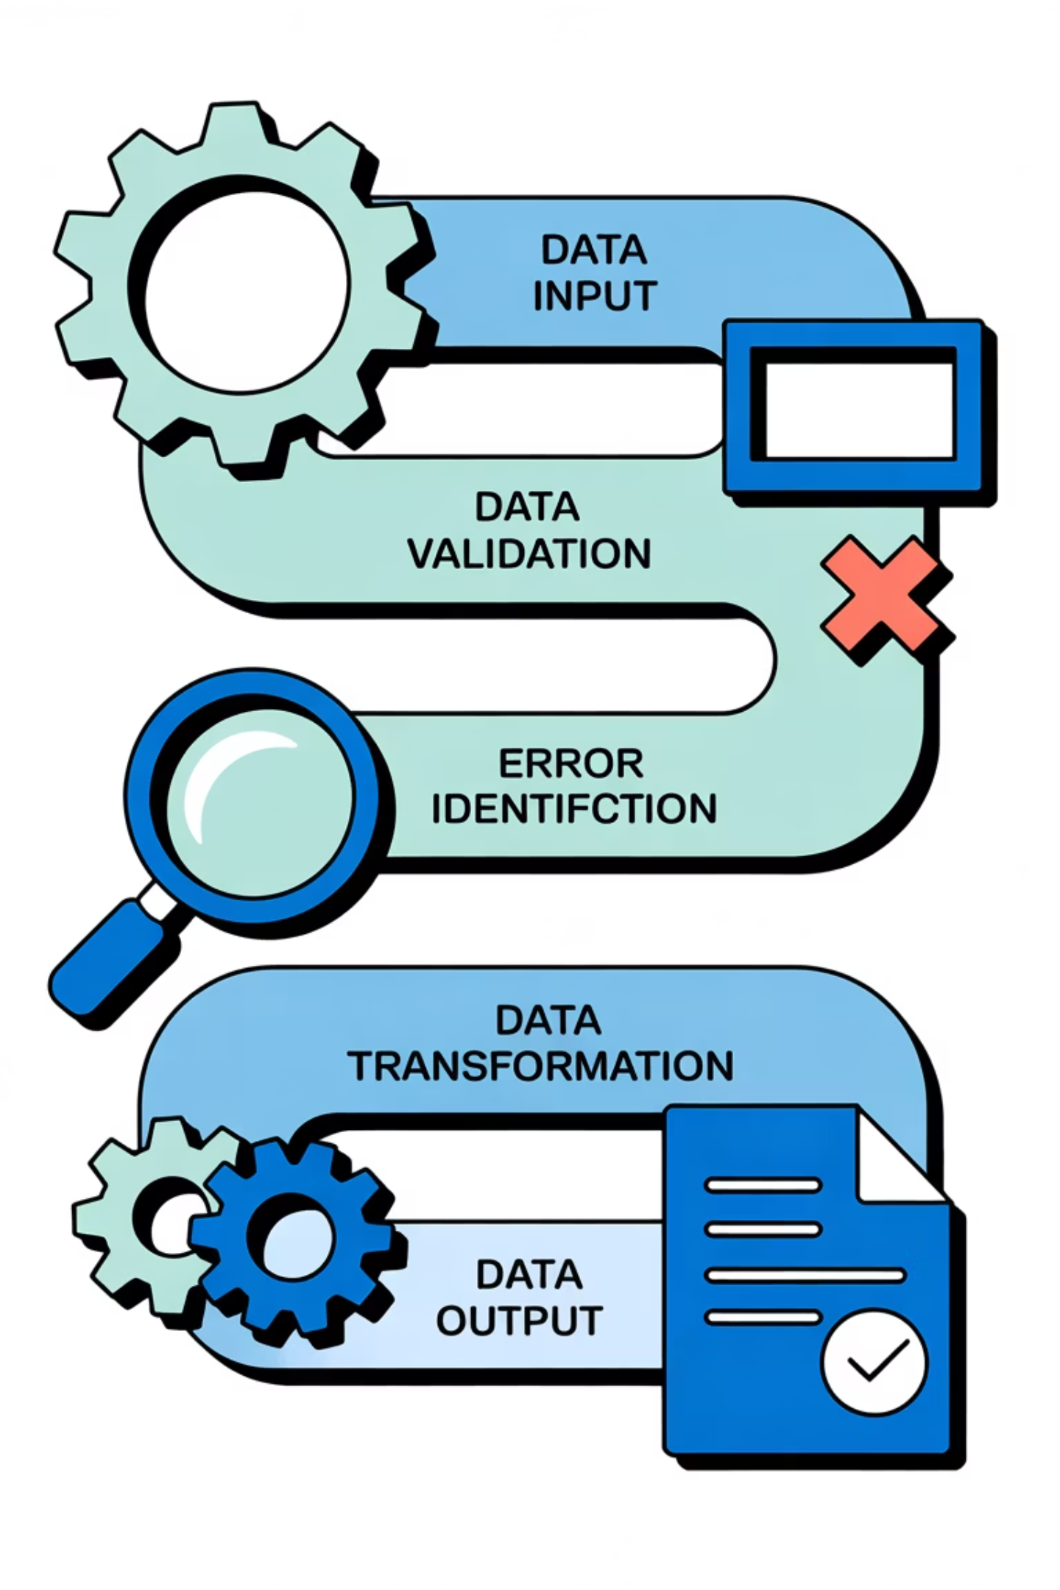

Data Preprocessing
Robust data preprocessing is essential for building reliable machine learning models. Our preprocessing pipeline ensures data quality and prepares features for optimal model performance.
01
Data Cleaning
Removed non-predictive ID column that provides no informational value for delivery time prediction
02
Missing Value Treatment
Identified and handled missing data points using appropriate imputation strategies to maintain dataset integrity
03
Categorical Encoding
Transformed categorical variables (Weather, Traffic, Vehicle Type) into numerical representations suitable for model training
04
Feature Scaling
Applied standardization after train-test split to prevent data leakage and ensure fair model evaluation
Critical Note: Feature scaling performed after splitting data to avoid information leakage from test set into training process

Slide 6

Feature Engineering
Target Variable Creation
We engineered a binary target variable from continuous delivery time measurements. Orders were classified based on whether they met expected delivery windows.
Fast (0): Deliveries within standard time threshold
Delayed (1): Deliveries exceeding expected duration
Distance Feature
Geospatial Considerations
Utilized pre-calculated distance metric from dataset rather than computing from raw coordinates
Latitude and longitude coordinates excluded from direct modeling
More accurate than Euclidean distance
Distance already captures spatial relationship
Accounts for actual road networks
Avoids redundant information
Reduces computational complexity
Simplifies model interpretation

Slide 7

Machine Learning Models Used
We implemented three distinct classification algorithms, each with unique strengths and approaches to the prediction problem. This multi-model strategy enables comprehensive evaluation and comparison of performance characteristics.
Naive Bayes
K-Nearest Neighbors
Probabilistic classifier based on Bayes' theorem with strong independence assumptions
Instance-based learning algorithm that classifies based on similarity to training examples
Fast training and prediction
Works well with high-dimensional data
Non-parametric approach
Effective for baseline comparisons
Captures local patterns effectively
No explicit training phase
Decision Tree
Tree-structured model that makes decisions through hierarchical feature splits
Highly interpretable results
Handles non-linear relationships
No feature scaling required

Slide 8

Naive Bayes Model
Working Principle
Naive Bayes applies Bayes' theorem with the "naive" assumption that features are conditionally independent given the class label. Despite this simplification, it often performs surprisingly well in practice.
The algorithm calculates the probability of each class given the input features and selects the class with highest posterior probability.
Mathematical Foundation
P(Class|Features) = P(Features|Class) × P(Class) / P(Features)
Accuracy
Precision
Overall correctness of predictions across all classes
Proportion of positive predictions that were actually correct
Recall
F1-Score
Proportion of actual positives that were correctly identified
Harmonic mean of precision and recall for balanced evaluation
Confusion Matrix: Visual representation of model performance showing true positives, false positives, true negatives, and false negatives will be inserted here

Slide 9


K-Nearest Neighbors Model
Core Concept
KNN predicts the class of a new data point by examining the classes of its K nearest neighbors in the feature space, using majority voting to make the final classification decision.
Algorithm Mechanics
Hyperparameter Selection
For each prediction, KNN:
K = 5 was chosen as our neighborhood size
Calculates distance to all training points
Balances bias-variance tradeoff
Identifies K closest neighbors
Reduces noise sensitivity
Takes majority vote among neighbors
Commonly used baseline value
Assigns predicted class
Provides stable predictions
Confusion Matrix: Performance metrics visualizing classification accuracy for fast and delayed delivery predictions will be inserted here

Slide 10

Decision Tree Model
Tree-Based Classification
Decision Trees create a flowchart-like structure where internal nodes represent feature tests, branches represent outcomes, and leaf nodes represent class predictions.
The algorithm recursively partitions the feature space to create homogeneous regions for each class.
Root Node
1
Initial split on most informative feature
2
Internal Nodes
Successive splits refine classification boundaries
Leaf Nodes
3
Final class predictions at terminal points
4
Pruning Strategy
To prevent overfitting and improve generalization, we applied regularization through pruning parameters:
max_depth
min_samples_split
Limits tree height to control model complexity and prevent excessive branching
Requires minimum samples before allowing node splits, ensuring statistical significance
Confusion Matrix: Decision Tree classification results showing predicted versus actual delivery outcomes will be inserted here

Slide 11


ROC Curve Analysis
Understanding ROC and AUC
The Receiver Operating Characteristic (ROC) curve is a fundamental tool for evaluating binary classification models. It plots the True Positive Rate against the False Positive Rate across various classification thresholds.
Key Metrics
Interpretation Guide
True Positive Rate (TPR): Sensitivity or recall of the model
AUC = 0.5: Random guessing
False Positive Rate (FPR): Proportion of negatives incorrectly classified
AUC > 0.7: Acceptable performance
AUC Score: Area Under the Curve, ranging from 0 to 1
AUC > 0.8: Excellent performance
AUC = 1.0: Perfect classification
Model Comparison: ROC curves for all three models (Naive Bayes, KNN, Decision Tree) will be displayed here for visual comparison of discriminative ability

Slide 12
Model Comparison
Model Performance Comparison
Model
Accuracy
Precision
Recall
Naive Bayes
0.85
0.85
1.00
K-Nearest Neighbors
0.825
0.85
0.97
Decision Tree
0.825
0.85
0.97
Class Imbalance Impact
Metric Selection
Model Strengths
Uneven distribution of Fast vs. Delayed deliveries affects model performance. Accuracy alone may be misleading when one class dominates the dataset.
F1-score provides more balanced evaluation than accuracy for imbalanced datasets, considering both precision and recall equally.
Each algorithm exhibits different performance patterns across metrics, revealing trade-offs between false positives and false negatives.

Slide 13

Results & Discussion
Key Findings
Our comparative analysis revealed important insights about model performance in the context of food delivery time prediction.
While all three models achieved reasonable accuracy, their behavior varied significantly when examining detailed performance metrics.
Model Performance
Class Imbalance Effects
Evaluation Complexity
Decision Tree demonstrated superior overall performance with balanced precision-recall characteristics
Unequal class distribution led to biased predictions favoring the majority class across all models
Accuracy alone insufficient—comprehensive metrics essential for true performance understanding
Critical Observations
The presence of class imbalance significantly influenced model behavior. Models tended to predict the majority class more frequently, achieving high accuracy while potentially missing important patterns in the minority class. This highlights the importance of using multiple evaluation metrics and considering the real-world costs of different types of misclassification in food delivery scenarios.

Slide 14
Conclusion
Project Outcomes
Successfully developed and evaluated three machine learning models for predicting food delivery time classifications, demonstrating practical application of classification algorithms to real-world logistics challenges.
Model Development
Data Pipeline
Built and trained three distinct classification algorithms with different theoretical foundations
Implemented comprehensive preprocessing and feature engineering workflow
Best Model Identified
Performance Analysis
Decision Tree emerged as top performer with optimal balance of accuracy and interpretability
Conducted rigorous evaluation using multiple metrics and visualization techniques
Practical Significance
This project demonstrates that machine learning can effectively predict delivery delays, enabling food delivery platforms to proactively manage customer expectations, optimize delivery operations, and improve overall service quality. The Decision Tree model's interpretability makes it particularly valuable for understanding which factors most strongly influence delivery times.

Slide 15






Future Enhancements
While our current models provide valuable insights, several opportunities exist to enhance prediction accuracy and practical applicability. These improvements would address current limitations and extend the model's capabilities.
Address Class Imbalance
Hyperparameter Optimization
Ensemble Methods
Implement techniques like SMOTE, class weights, or undersampling to balance the dataset and improve minority class prediction
Conduct systematic grid search or random search to identify optimal parameter configurations for each model
Explore Random Forests, Gradient Boosting, or Stacking to combine multiple models for improved accuracy
Advanced Feature Engineering
Deep Learning Approaches
Production Deployment
Create interaction terms, temporal features, and domain-specific variables to capture complex relationships
Investigate neural network architectures for potentially capturing more complex non-linear patterns
Develop real-time prediction API and monitoring system for operational use in delivery platforms

Slide 16

Thank You!
We appreciate your time and interest in our Food Delivery Time Prediction project.
Contact Us
For any questions or further discussion, please reach out to:
abhishawhaval@gmail.com

